Slide 1
Machine Learning for GIS
Parmanand Sinha, PhD
Research Computing Center
University of Chicago

Slide 2
About RCC-GIS
Support for Geospatial Information Science Research
Assistance for all UChicago students, faculty, and staff
Training
Consultation
Events
https://gis.rcc.uchicago.edu

Slide 3
OUTLINE
Spatial Data
Spatial Data Types and Formats
GIS software
Spatial Analysis
Spatial Econometrics
Geostatistics
Spatial Analysis Software

Slide 4
Spatial and Tabular Data
Geometry + Attributes
Points
ID | Color | Use
1 | Blue | Hospital
2 | Red | Fire Dept.
3 | Green | Oﬃce
4 | Yellow | University
5 | Black | Retail

Slide 5
TYPES OF SPATIAL DATA FORMATS
Vector (points, lines and polygons) vs Raster (grid).
Vector:
ESRI Shapefile is the near universal standard now.
Google kml
Raster:
Lots of formats for raster, but raster are rarely encountered in spatial analysis of socio-economic data.

Slide 6
SHAPEFILES
A "shapefile" is actually a group of 3+ files with the same name but different extensions. .shp, .shx, .dbf, optional files include .prj, .shp.xml, .sbn, .sbx, ...
.shp – stores geometry
.dbf – stores attributes
.shx – index file
.prj – projection file
.xml – metadata file
Just make sure that they all stay together, and never try to edit them outside of a GIS package.
Topology?

Slide 7
GIS SOFTWARE
ArcGIS is the industry leader.
Open-source mapping and visualization software: QGIS
R/Python for Analysis
Dr. Luc Anselin and CSDS UChicago GeoDa
Spatial Database like PostGIS

Slide 8
SPATIAL STATISTICS SPATIAL ANALYSIS SOFTWARE
SAS - Fits geostatistical models (PROCs VARIOGRAM, KRIGE2D). SAR-Error: by coercing PROC MIXED. SAR-Lag: No.
R does everything, but the learning curve is high.
GeoDa: Really good for beginners. Slighter learning curve.
https://geodacenter.github.io
PySAL: python library. Similar to GeoDa, but more extensible.
ArcGIS generally not recommended for any statistical tasks.

Slide 9
Distances in GIS
y
j
j
j
i
i
k
k
i
k
x
Euclidean distance on the plane
Great circle distance
Network distance

Slide 10
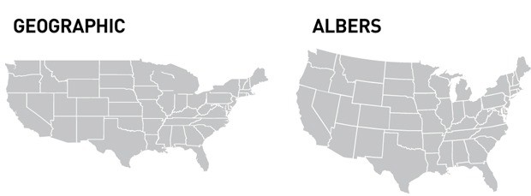
GEOGRAPHIC PROJECTIONS

Slide 11
GEOGRAPHIC OR PROJECTED COORDINATES?
Geographic coordinates: latitude and longitude
Non-Euclidean, so don’t try calculating area, perimeter or distance.
Projected coordinate systems have converted lat/lon to x/y,
Introduces distortion.
Useful for calculations, and for visualization.
Project if you need to do geographic calculations. Caveat, most GIS provide routines for great circle distance, so you can use these.

Slide 12
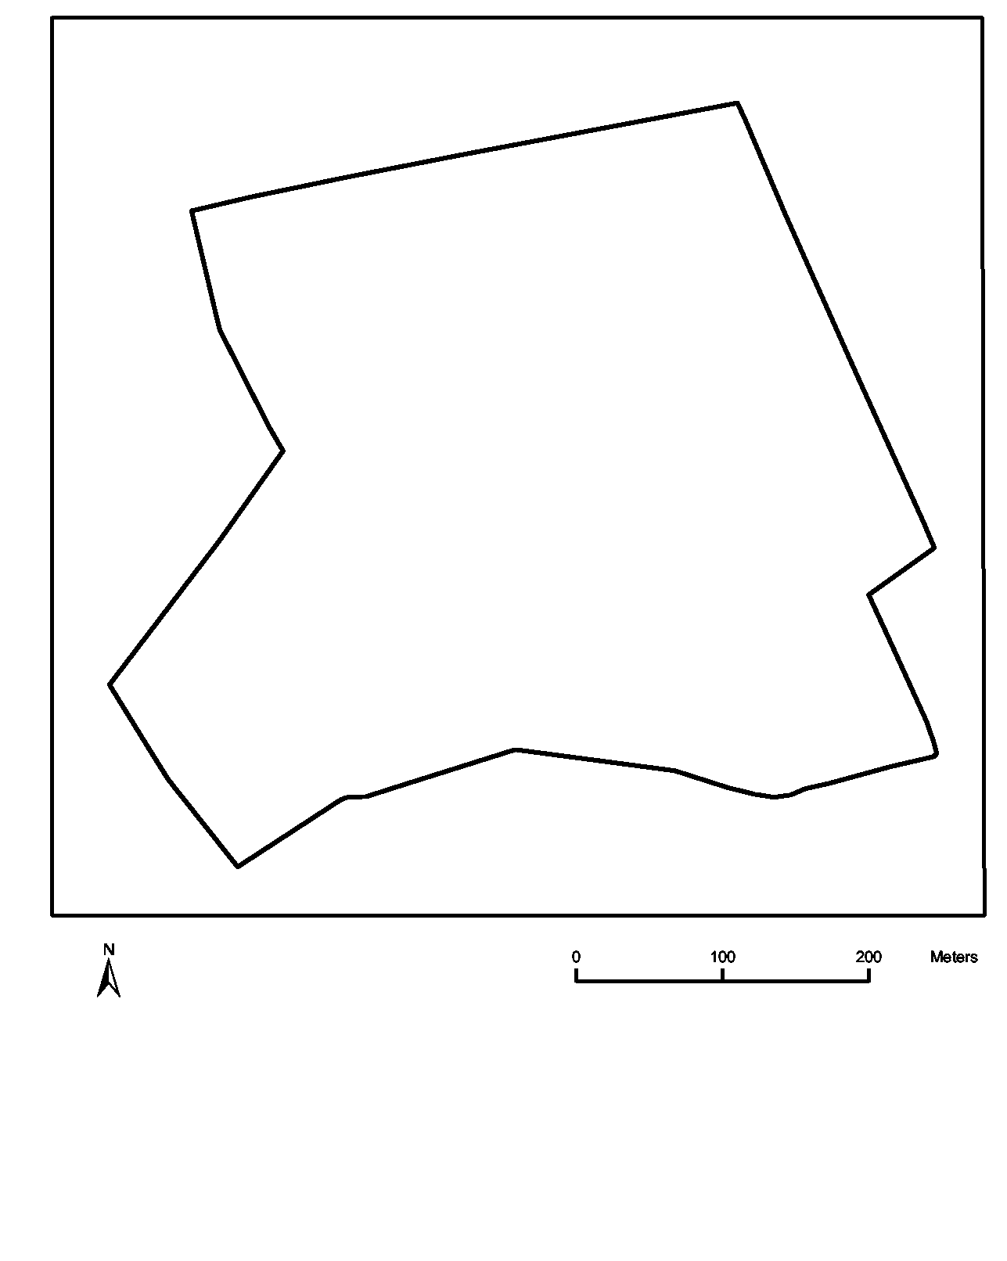
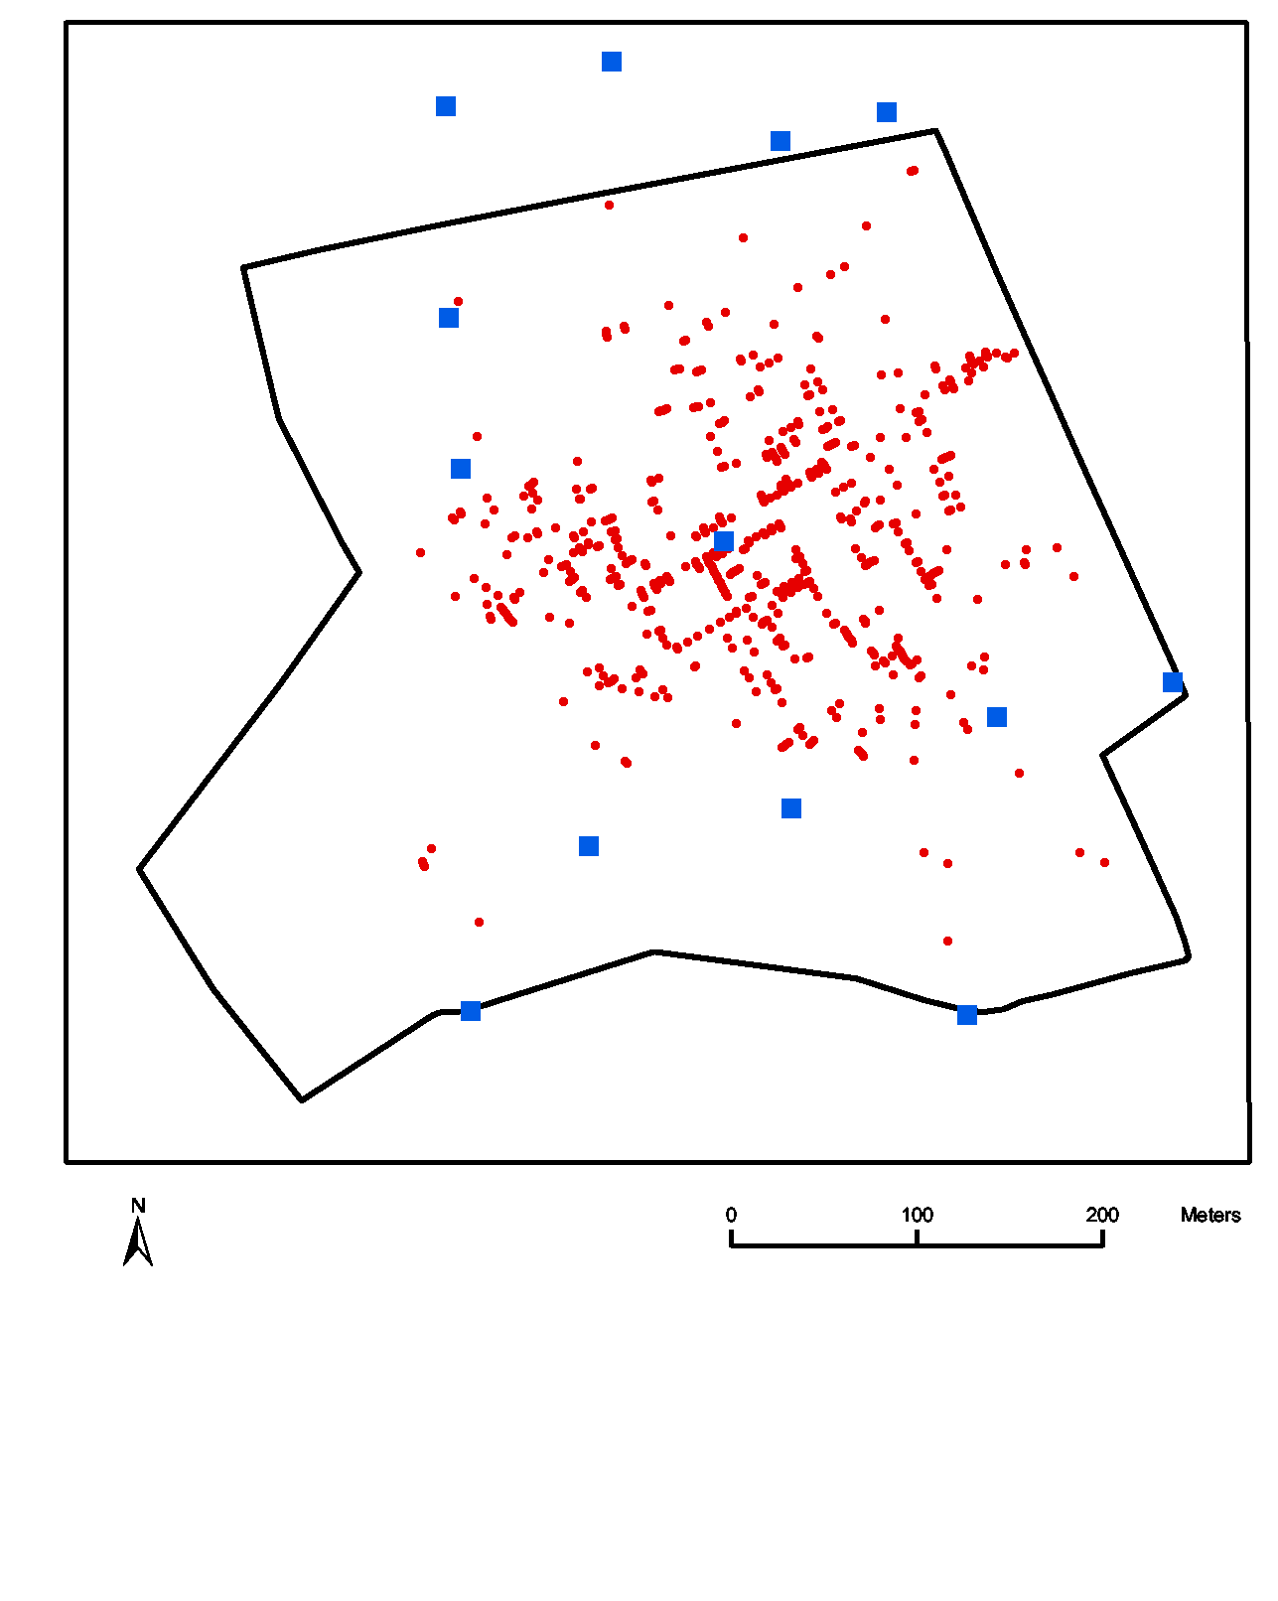
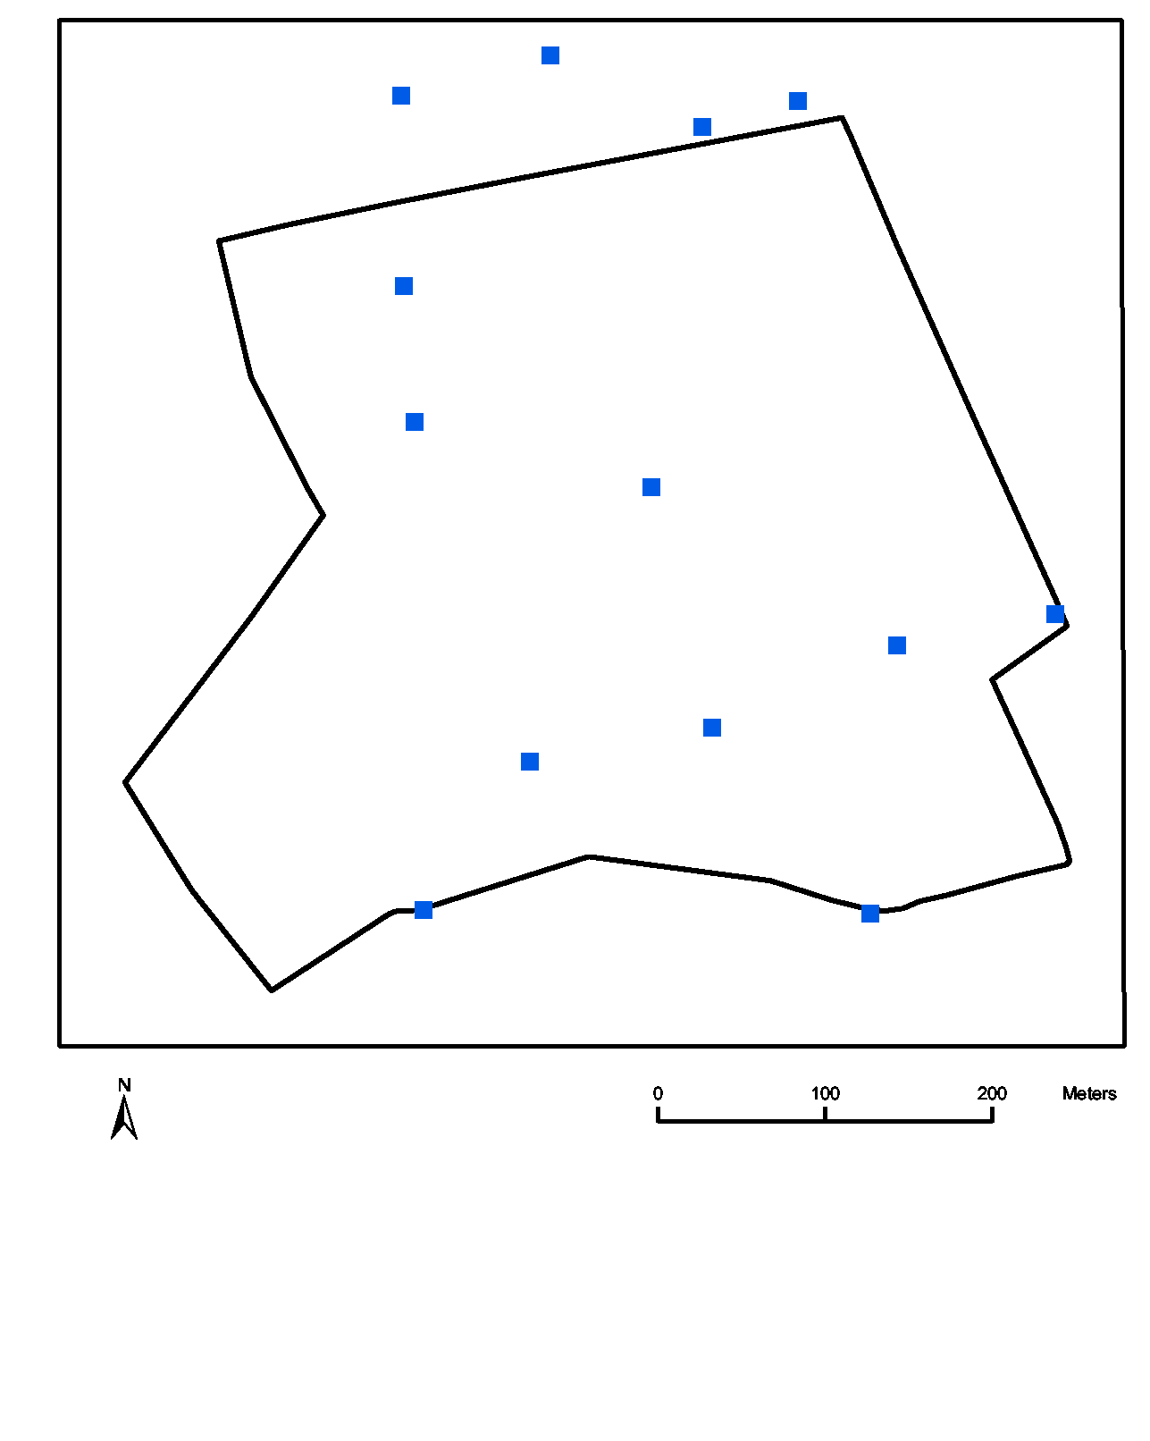
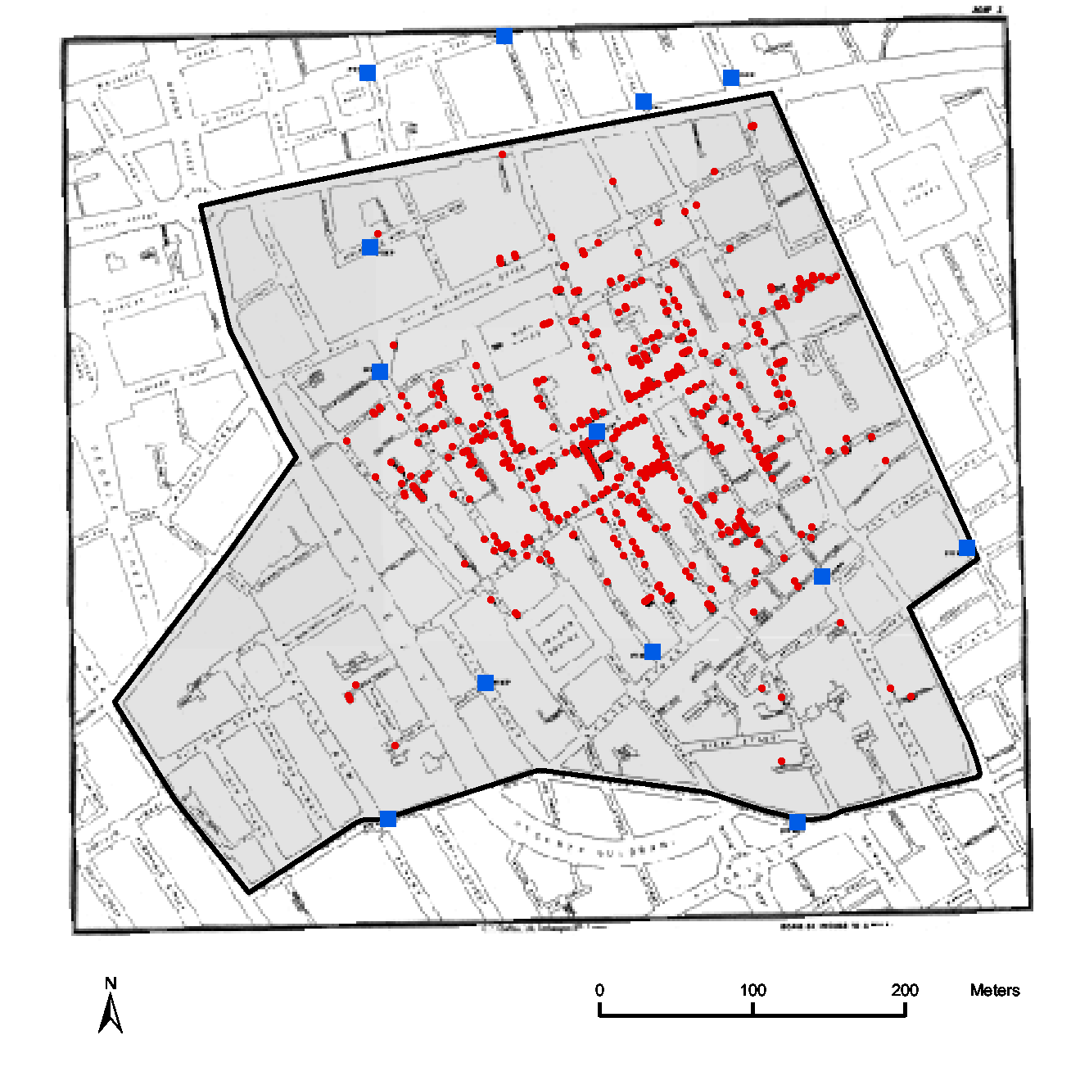
Counts of cholera deaths recorded by Snow in the Broad Street pump neighbor-hood and vicinity (London) during the outbreak of 1854.

Slide 13
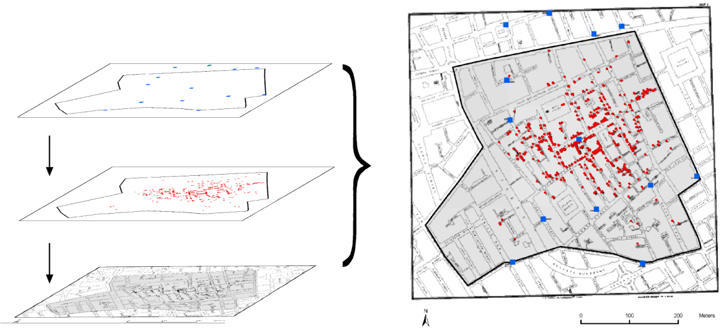
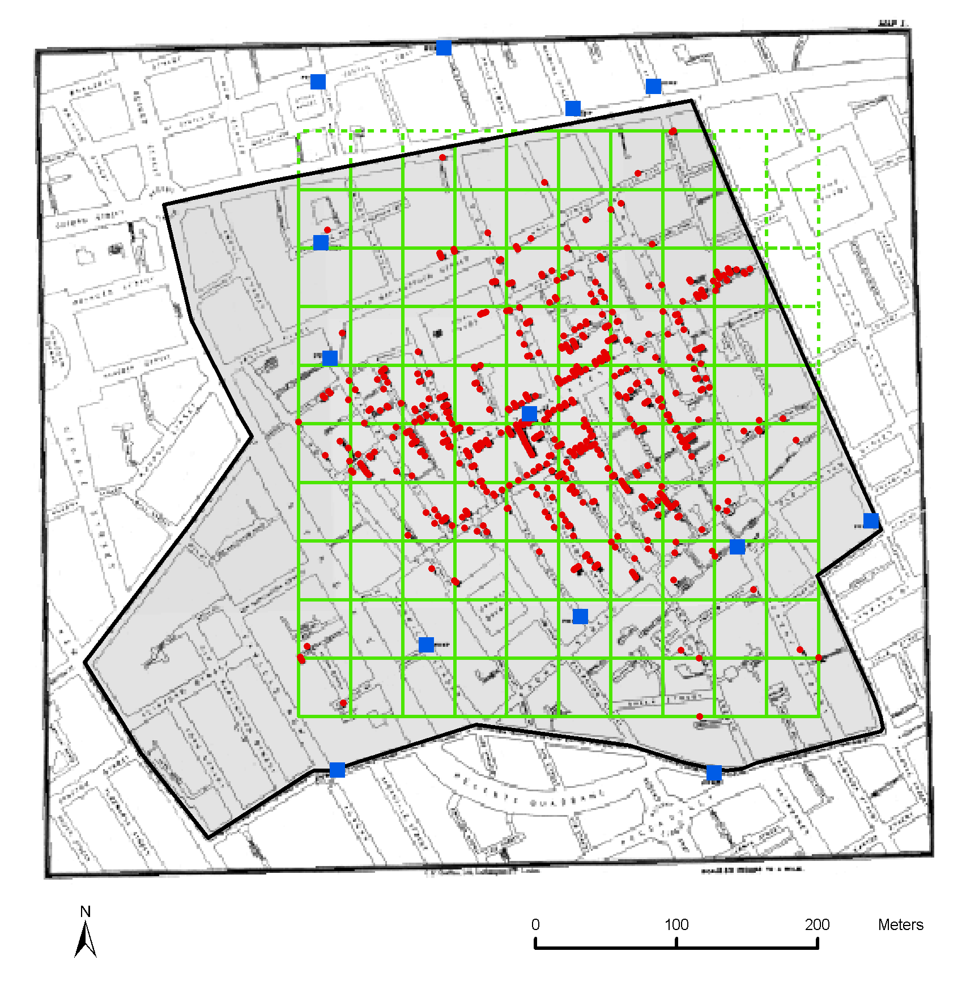
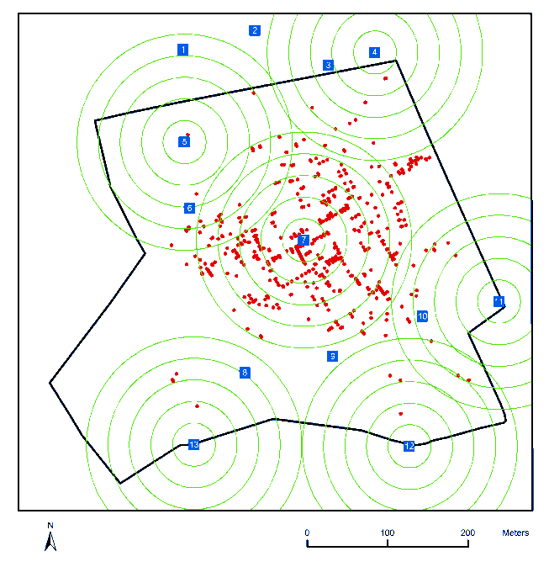
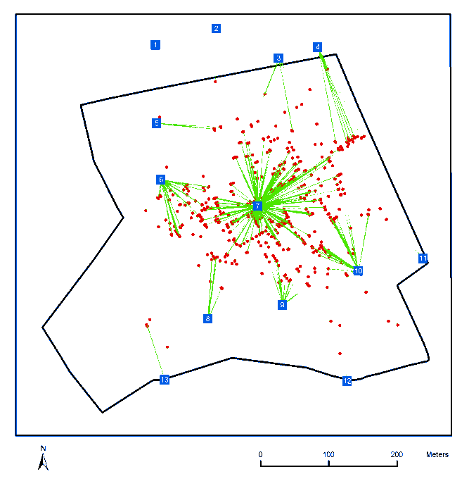

Slide 14
Tobler’s 1st Law of Geography Everything is related to everything else, but near things are more related than distant things

Slide 15
Spatial Scale
The spatial scale of variation links to the concept of spatial dependence –
Spatial autocorrelation and spatial dependence

Slide 16
WHY USE A SPATIAL LINEAR MODEL?
If there are omitted covariates with a spatial pattern, or if there are spatial dependencies, then,
At best, OLS t-statistics are too large, and
At worst, OLS coefficients are biased and inconsistent.

Slide 17
TYPES OF SPATIAL DATA: EXAMPLES
Fields:
Temperature, rainfall, accessibility
Networks/Lattices
County tax rates
Point Patterns
Tree locations.
Disease locations.

Slide 18
TYPE OF SPATIAL PATTERNS: EXAMPLES
Each type of data has its own methods, and often, its own software.
It’s not always easy to determine which type is appropriate:
Houses with values: Field? Network? Point Pattern?
Census tracts with average house values: Network? A field/point pattern that has been aggregated?

Slide 19
TYPES OF SPATIAL DATA: PROCESSES
Fields (aka Geostatistics)
Usually specified by an autocovariance function. Cov(e_{i}, e_{j} ) = C(d_{ij; α})
Lattices/Networks (aka Spatial Econometrics)
Usually specified by an interaction matrix (spatial weights matrix)
Point Patterns
Usually modeled similarly to Fields, but dependencies are possible for both point density and attributes.
Can be tricky: if points are clustered, is it because they are mutually dependent, or do they appear clustered only because they depend upon some underlying covariate.

Slide 20
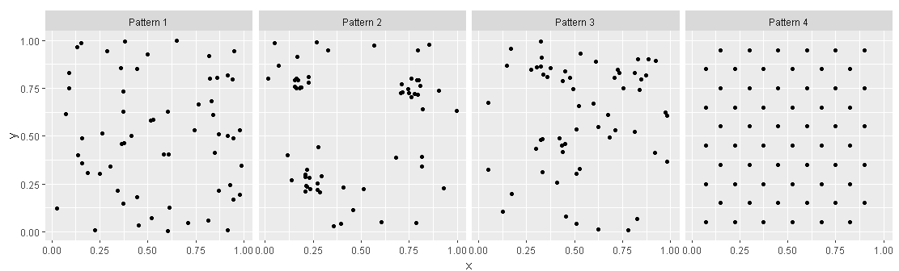
Point Patterns
- A point pattern is a statistical map where the location of the event is the outcome of a process
A region has an infinite number of points (coordinates) on the plane
PointPatterns <-read.csv(“./data/ PointPatterns.csv)
ggplot() + geom_point(data = PointPatterns, aes(x = x, y = y)) + facet_grid(.~ Pattern) + coord_fixed()

Slide 21
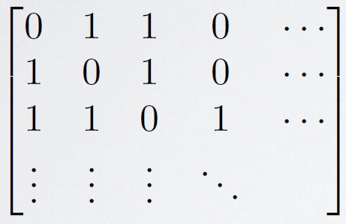
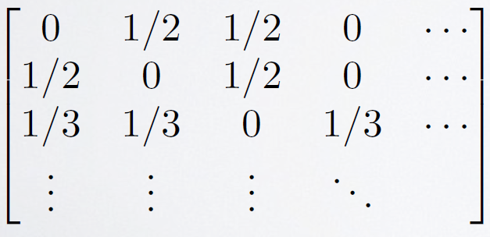
DEFINING RELATIONS IN A NETWORK/LATTICE
The weights matrix W specifies connections. It is usually based on contiguity of regions.
The weights matrix is often “row standardized” so that it is a spatial moving average.

Slide 22
WEIGHT MATRIX DEFINITIONS
Binary contiguity is the most common for area-type data.
Distances between centroids:
K nearest neighbors (kNN).
fixed radius
Contiguity, with weights based on length of border.

Slide 23
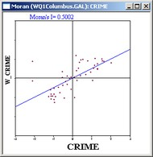
EXPLORATORY ANALYSIS: MORAN’S SCATTERPLOT
A plot of weighted average of neighbors vs the original observations.
The correlation coefficient is called Moran’s I.
In general, testing whether I=0 is difficult. Most routines provide methods that are based on resampling.

Slide 24
SPATIAL LAG VS SPATIAL ERROR MODELS
Spatial Lag Model
Y = ρWY + Xβ + e
Spatial Error Model
Y = X β + u
u = λWu + e
Computation and interpretation of coefficients is much easier for the error model.

Slide 25
SPATIAL LAG MODEL
Y = ρWY + Xβ + e
If the lag model is true, but you fit OLS, then the coefficients are biased.
Dedicated software will do it correctly.

Slide 26
LAG OR ERROR?
Lagrange Multiplier Test
but, statistically, it can be difficult to distinguish between the two. These tests seem to have low power in finite samples.

Slide 27
GEOSTATISTICS
Y= Xβ + e; Cov(ei, ej ) = f(dij )
The basic geostatistical model is nothing other than Generalized Least Squares (GLS), but with specialized terminology.
The autocovariance function f() is the “covariogram.”
Covariogram parameters are “nugget”, “range” and “sill.”
Prediction is called “kriging,” but it’s just Best Linear Unbiased Prediction (BLUP).

Slide 28
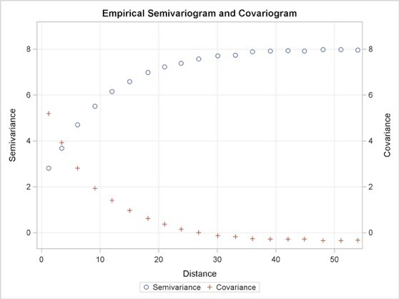
GEOSTATISTICS
Covariogram = a function for distance decay in covariances.
Semivariogram and covariogram just inverses.
For reasons that aren’t relevant to us, the original geostatistician preferred the semivariogram to the covariogram.

Slide 29
FITTING COVARIOGRAM MODELS
Plot the empirical semi variogram, and then fit a curve to it.
You can’t use just any curve, there are some mathematical constraints on it.
Model based mathematical functions are used.

Slide 30
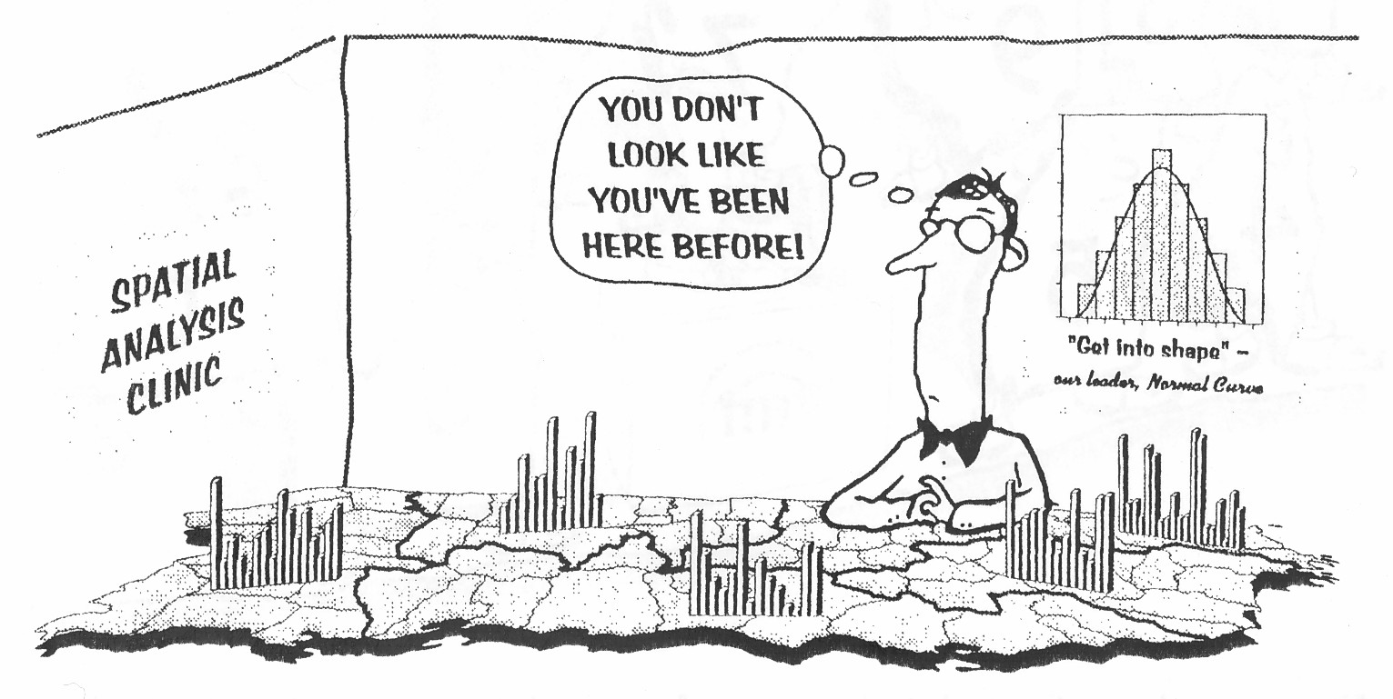
Spatial Autocorrelation leads to variance inflation resulting model’s deviation from expected distribution

Slide 31
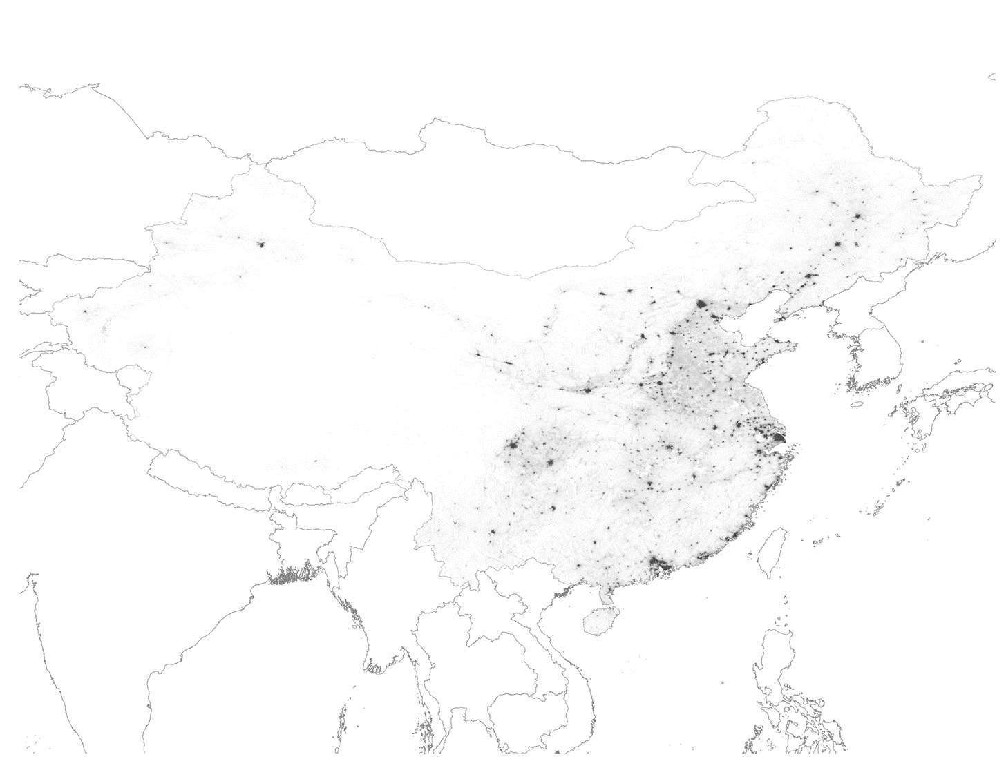
Spatial Heterogeneity
General Chinese population distribution - is the distribution unequal from the West to the East?

Slide 32
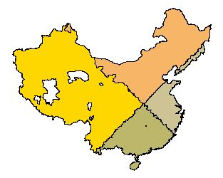
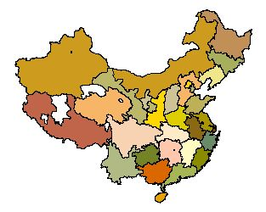
Constant Variance
Variable transformations often stabilize the variance of a variable across the geographic landscape over which it is distributed
Quadrants of the plane/established areal unit groupings give a heuristic assessment of constant variance across a geographic landscape
Plane quadrants
provinces

Slide 33
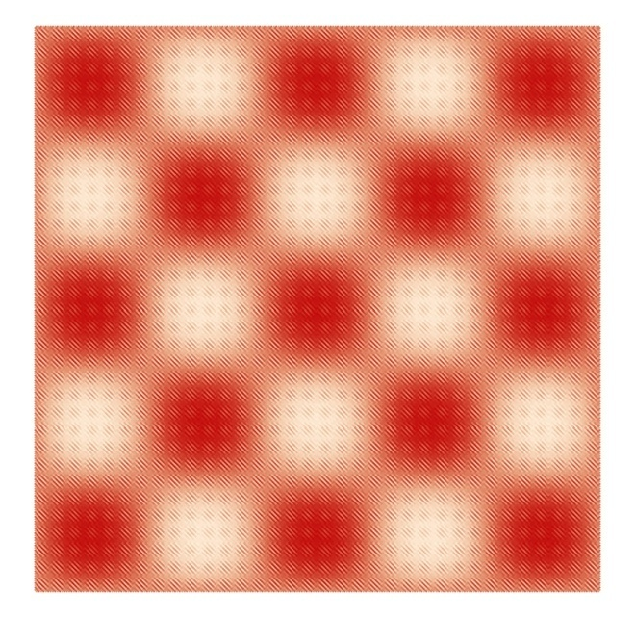
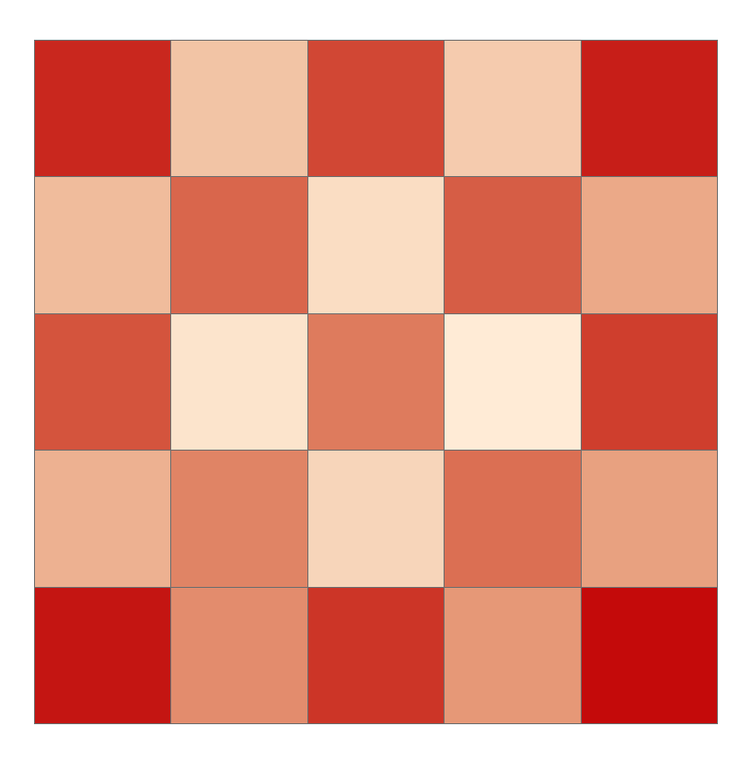
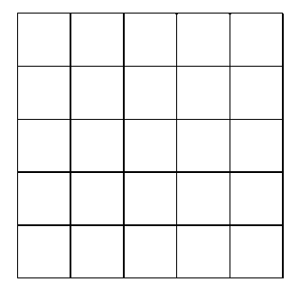
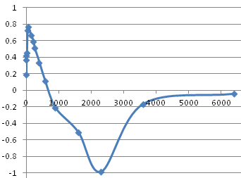
The MAUP: # areal units; shape constant
dimension | average # pixels | MC
240-by-240 | 1
120-by-120 | 4 | 0.366
80-by-80 | 9 | 0.418
60-by-60 | 16 | 0.456
40-by-40 | 36 | 0.726
30-by-30 | 64 | 0.765
20-by-20 | 144 | 0.666
16-by-16 | 225 | 0.593
15-by-15 | 256 | 0.513
12-by-12 | 400 | 0.338
10-by-10 | 576 | 0.116
8-by-8 | 900 | -0.214
6-by-6 | 1,600 | -0.507
5-by-5 | 2,304 | -0.982
4-by-4 | 3,600 | -0.164
3-by-3 | 6,400 | -0.043
.
.
.
.
.
(Griffith, 2003)

Slide 34
Going from the global to the local
Anselin’s (1995) seminal paper about indices of spatial association (i.e., LISA statistics)
Getis and Ord’s (1992, 1995) Gi and Gi* statistics
Identify clustering
Identify particular clusters (significant local clusters in the absence of global autocorrelation)
distinguish between homogeneity and heterogeneity (e.g., spatial outliers - highs surrounded by lows, and vice versa)

Slide 35
Geographic clusters: an overview
Global cluster tests search for spatial clusters anywhere in a study area but do not necessarily identify where the clusters occur and are used to identify departures from spatial randomness when overall spatial pattern is considered.
Local cluster tests identify locations at which there is some excess/deficit—a hot/cold spot—anywhere within a study area.
Focused cluster tests determine whether there is an excess near a pre-specified location, called a focus, and are used to detect clustering near, say, putative hazards (e.g., a toxic waste dump).

Slide 36
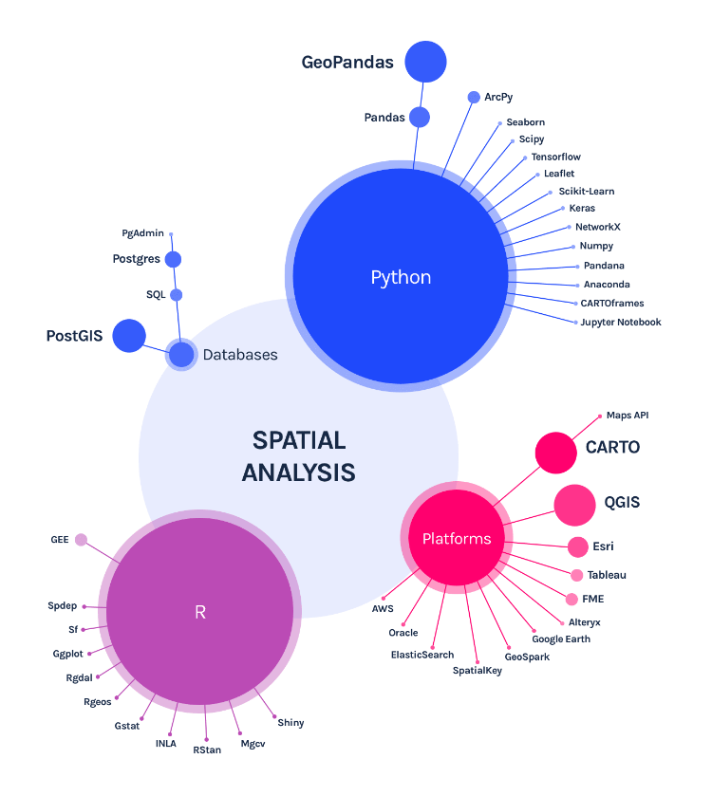
R still has a more complete offering for specific geospatial libraries (vs Data Science more generally).
https://carto.com/what-is-spatial-data-science/

Slide 37
Part III Models

Slide 38
What are ensemble models?
Combines the results from different models
Models can be a similar type or different
The result from an ensemble model is usually better than the result from one of the individual models

Slide 39
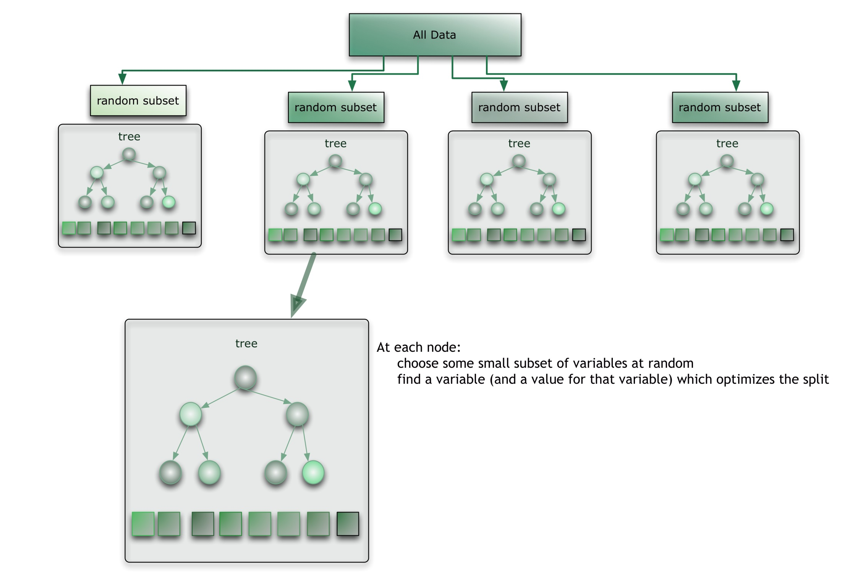
Classical models vs Random Forest
Linear regression is based on estimator whereas Random Forest could be compared to a meta-estimator.

Slide 40
Code

Slide 41
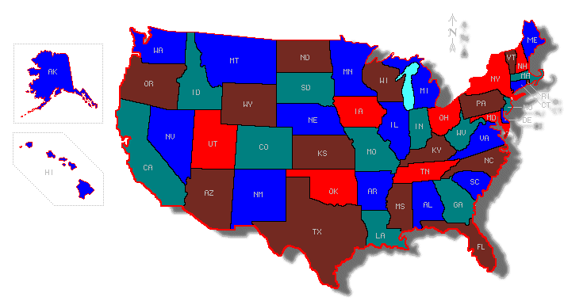
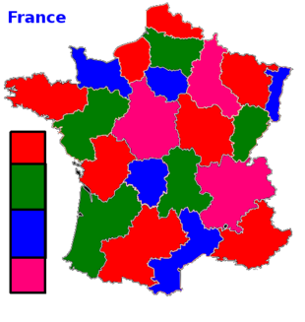
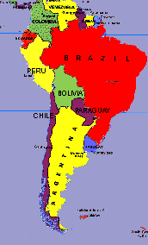
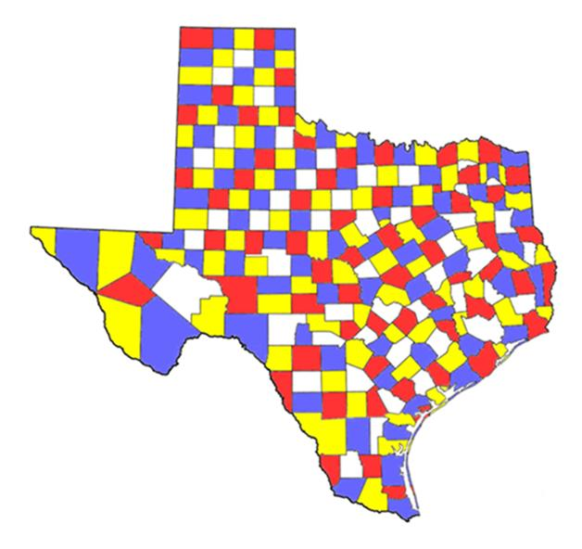
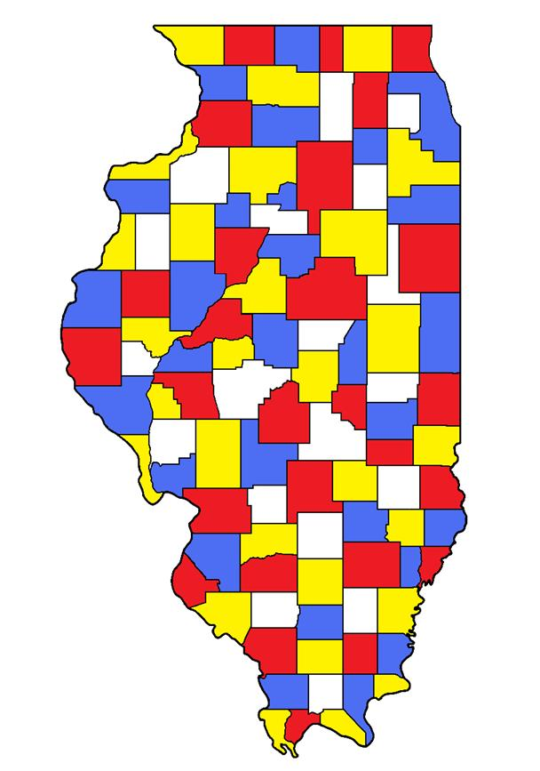
How many colors we need so that no two adjacent regions have same color?

Slide 42
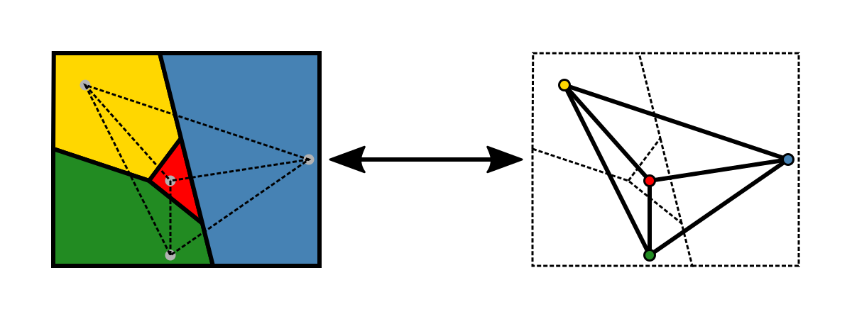
How many colors we need so that no two adjacent regions have same color?
This Photo by Unknown Author is licensed under CC BY-SA
Four color map theorem

Slide 43
Questions

